Slide 1
Inspire Optimization
Ryan Day

Slide 2
Problem
I wanted to see if Inspire can come up with a 3D printable chair that uses as little material as possible in order to support the weight of a person
There will be a market for 3D printed chairs in the future
My other goal was to have a cool organic looking chair
Chairs are used every day and an interestingly designed chair can spark joy which increases productivity

Slide 3
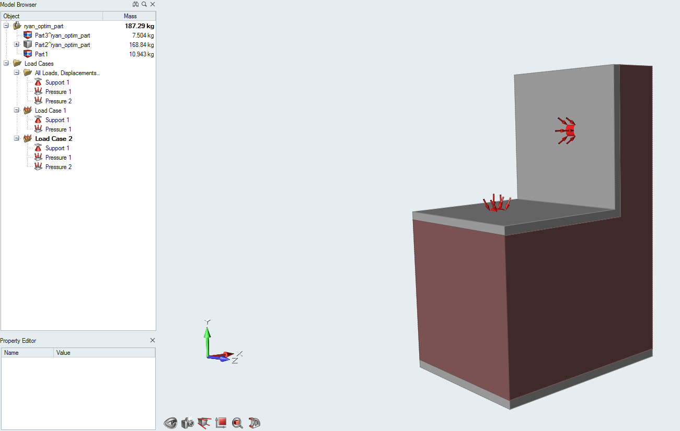
Chair Parameters
Material was ABS plastic
Dimensions of the seat were 1.5 ft by 1.5 ft, and the chair was ~3 feet high in total. I measured my own chair for a benchmark and it was about equal to those dimensions
Made in SOLIDWORKS and imported into Inspire

Slide 4
Design Space
150 lbs. pressure force down on the chair
20 lbs. pressure force going against the back of the chair
The bottom of the chair was constrained and couldn’t move

Slide 5
Design Experimentation
I tried to use minimize mass but it did not converge when I did that
I eventually used maximize stiffness, and kept lowering it and tweaking parameters until it converged with 5% volume filled

Slide 6
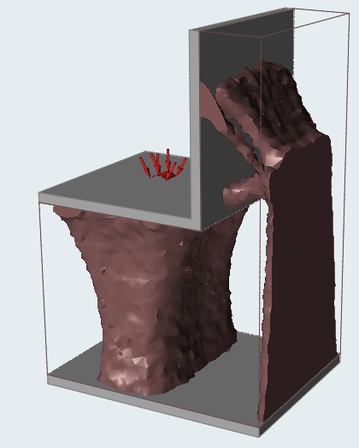
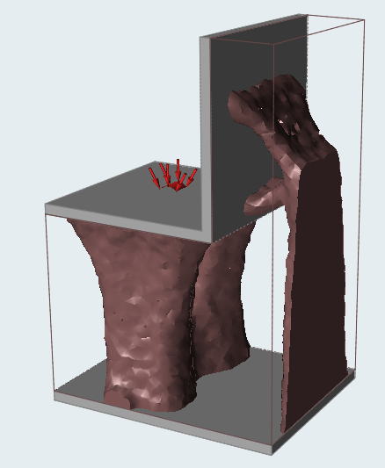
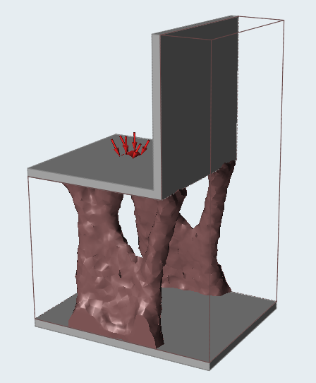
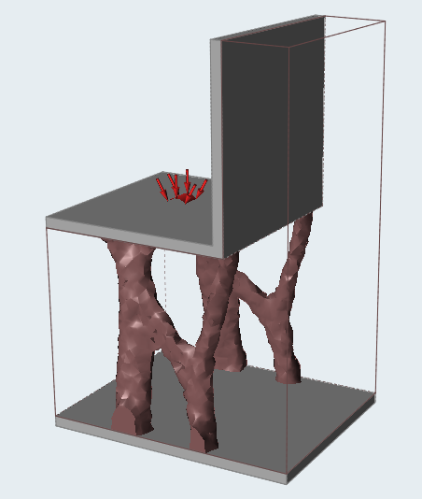
Design Iterations
Final Design

Slide 7
Results
Final design supports are 3D printable with no overhang greater than 45 degrees
The minimum factor of safety was 11 for the model, that gives me confidence it won’t break
Weight = ~8 lbs which costs about 100 dollars (ABS material)
This is comparable and cheaper than many office chairs in the market
More complex load cases could be done, but I was constrained by time

